Slide 1
CS 347 Project
Erica Halpern, Lindsey Kehlmann, & Michelle Lawrence

Slide 2
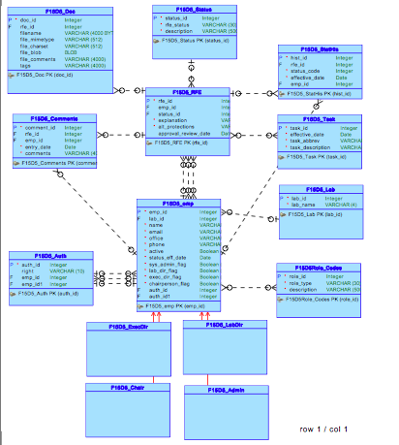

Slide 3
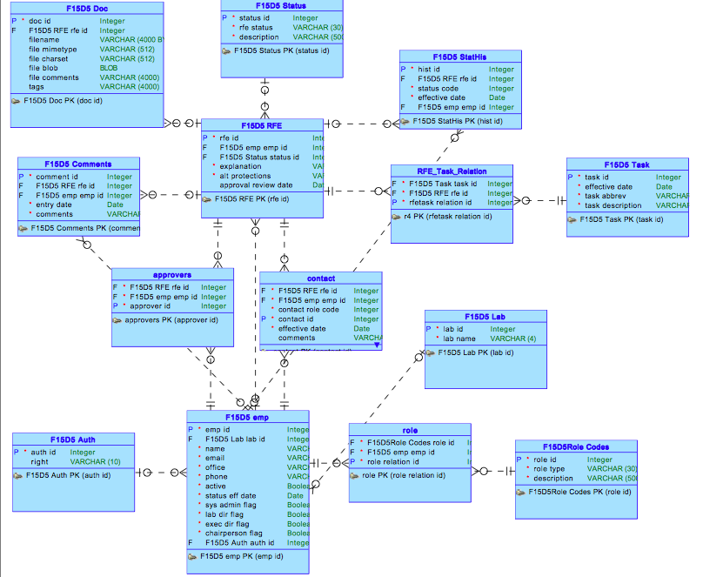

Slide 4
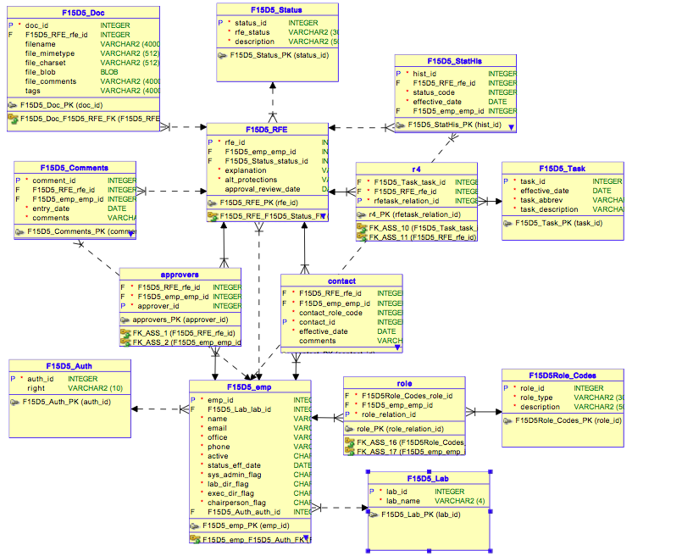

Slide 5
Application screenshots

Slide 6
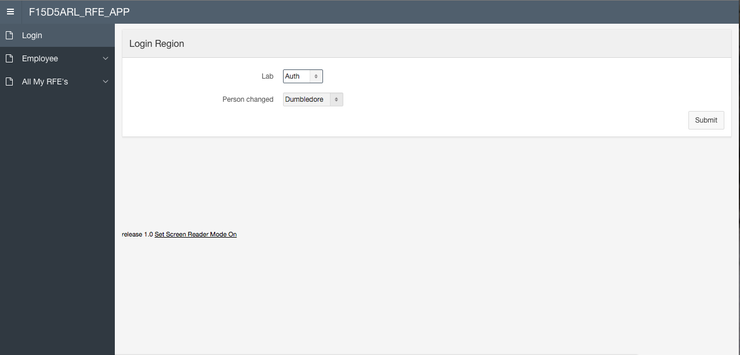

Slide 7
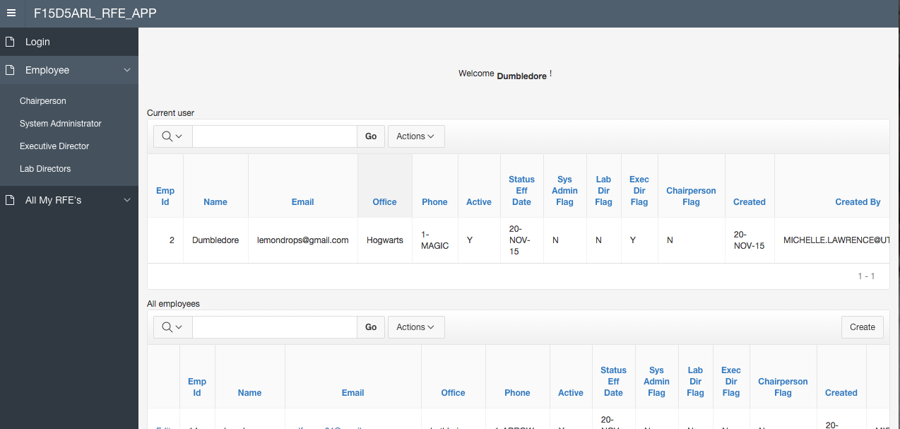

Slide 8
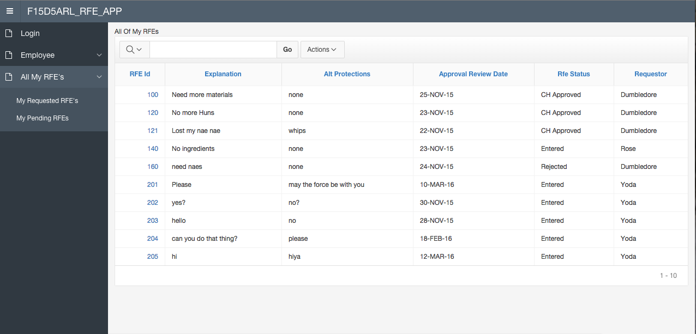

Slide 9
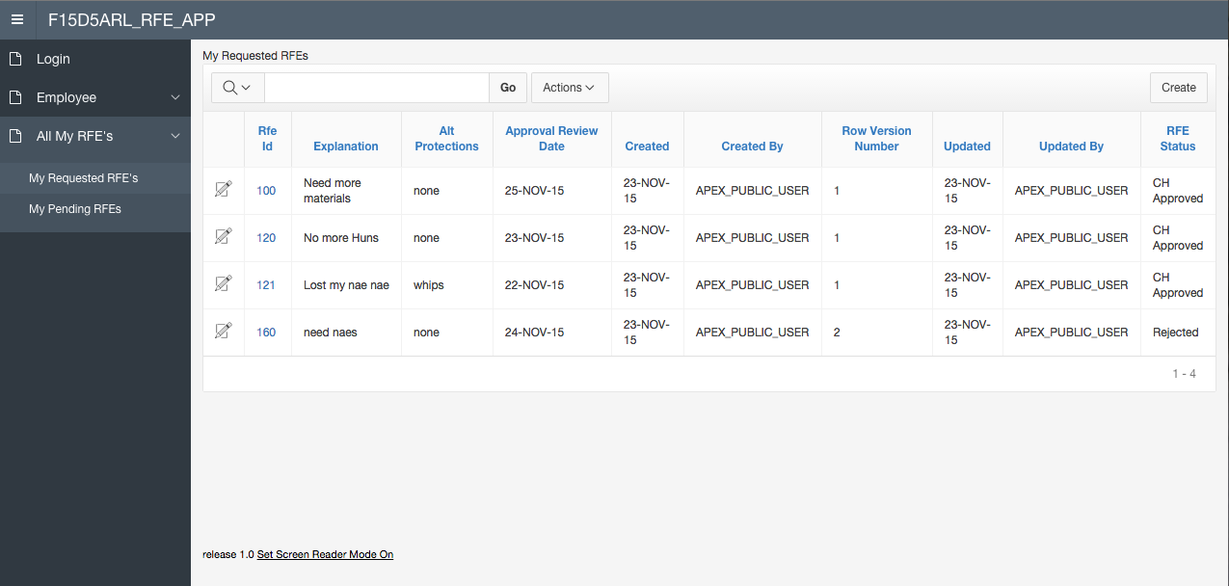

Slide 10
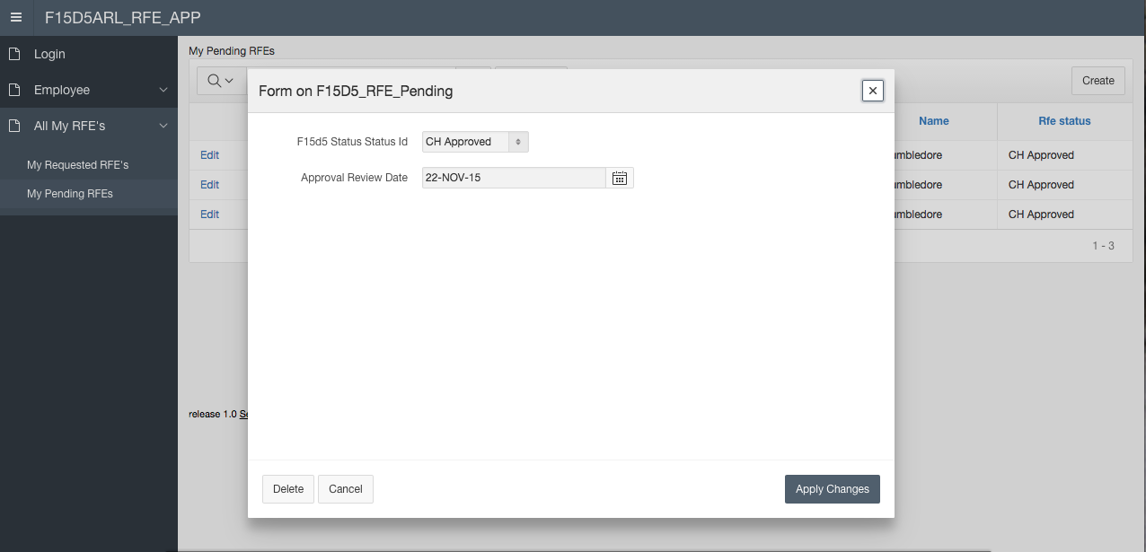

Slide 11
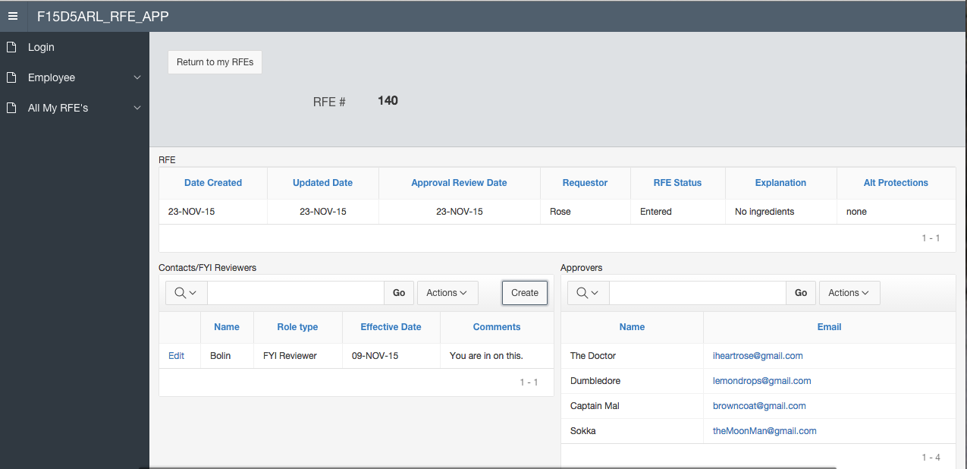

Slide 12
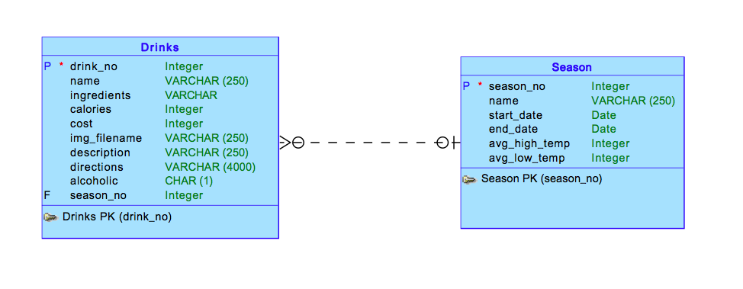
Part II Conceptual Model

Slide 13
Part II Description and screenshots
Part II of our project is meant to act like a beverage menu depending on season.
Seasonal drinks are displayed with prices, descriptions, ingredients, etc.

Slide 14
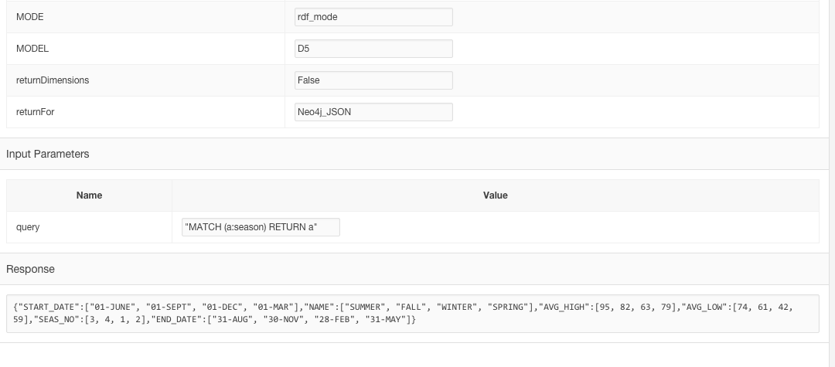

Slide 15
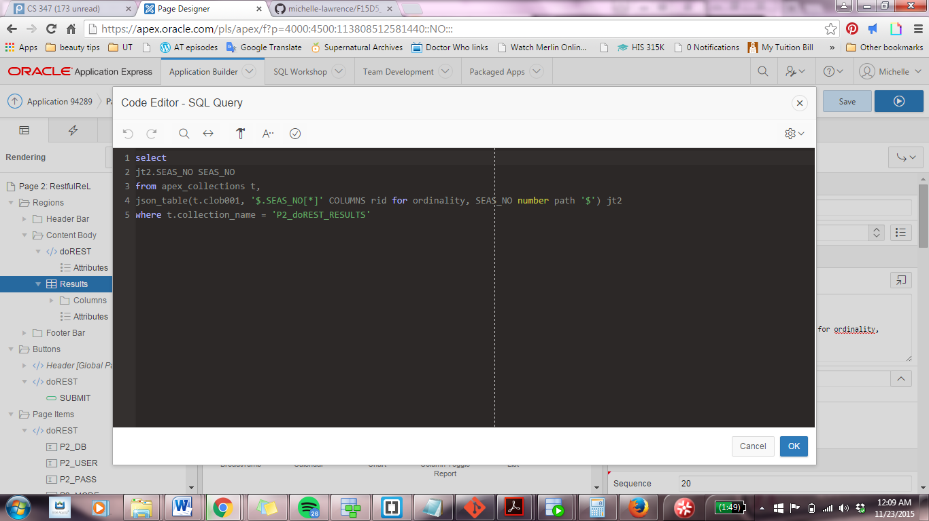

Slide 16
Github repo

